Slide 1
Connecting PHP to MYSQL
Tutor: Warnner D. Amin

Slide 2
Objectives
At the end of this discussion you will be able to
Know the different requirements and considerations in running a PHP programs
To demonstrate how to install application concerning in running PHP codes.
To identify proper PHP function syntax in relation to connecting PHP to MySQL
To identify PDO and MySQLi advantages and its legacy.
To demonstrate how to run a PDO and MySQLi (procedural or OOP way) applying local and hosted connections.

Slide 3





Topics Covered
Requirements and consideration in running PHP programs
Installation process and testing
Database connection functions syntax and parameters
PDO, MYSQL (OOP & Procedural), and MySQL Legacy
Demonstration:
Local and Hosted Connection

Slide 4
Topic 1: Requirements and Considerations
Requirements
Considerations
If you want to install separately
PHP installer (separate installer)
MySQL installer (separate installer)
Text Editor (suggest: Sublime or notepad++)
If you want to install it in a package server
XAMPP (Cross platform)
WAMP (Windows only)
LAMP (Linux only)
MAMP (Mac OS only)
Text editor (Any)
Download PHP in www.php.net/downloads
Download MySQL in https://dev.mysql.com/downloads/installer/
In running PHP programs using a server package you must consider the platform that you might used. In this case of windows platform you have two option, you may use a cross platform that runs in all platform or an exclusive server for windows the WAMP.
All things follows as well as in the other package server.
Consider also that you have prior knowledge of PHP before engaging to database like mysql.

Slide 5
Topic 2: Installation and Testing
Need to Install the ff:
XAMPP (PHP, APACHE, MYSQL)
SUBLIME TEXT

Slide 6
Topic 3: MySQL connection syntax and Parameters
Syntax and Parameters
Object oriented style:
$mysqli -> new mysqli(host, username, password, dbname, port, socket)
$mysqli -> connect_errno
$mysqli -> connect_error
Procedural style:
mysqli_connect(host, username, password, dbname, port, socket)
mysqli_connect_errno()
mysqli_connect_error();
PDO style:
New PDO($host, $user, $password) with try and catch condition

Slide 7
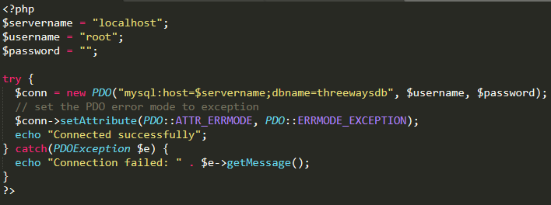
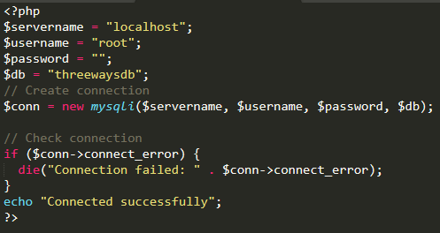
Topic 4: PDO, MySQLi and MySQl legacy
PHP Data Object
MySQLi (OOP & Procedural)

Slide 8
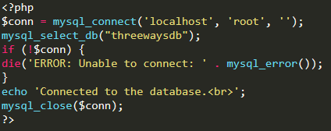
MySQL Legacy

Slide 9
Advantages and Supports
PDO
MySQLi
The main advantage of PDO to MySQLi is the database driver support.
PDO support 12 different drivers namely CUBRID, MS SQL Server, Firebird/Interbase, IBM, Informix, MYSQL, Oracle, ODBC and DB2, PostgreSQL, SQLite, 4D etc. with 18 different databases
With the MySQLi it only supports MySQL database
for the "procedural" it was said that it was for amateurs, only used procedural for simple programs and scripts
for the "oop" having more complex requirements and the program change over time oop might be a good choice in building bigger systems and applications.

Slide 10
Cont. Advantages and Supports
PHP 5.5 above version using the traditional legacy mysql functions has been deprecated, it will show an error deprecated.
But traditional or the legacy codes will not run anymore in PHP 7.0 version because it was removed.
If your code is using a traditional legacy mysql you need to use the lower version of php 5.5 below

Slide 11
Demonstration (Running programs)
Demonstration

Slide 12
I always said this to my students, always think outside the box learn from me but don't stick your ideas to me. Even I need to learn new things, and so do you. So all the learning that you get from me is just a guide, use it and be the better person facing real world problems

Slide 13
Thank You and God bless

